Slide 1
Lecture 21
P and NP Problems

Slide 2
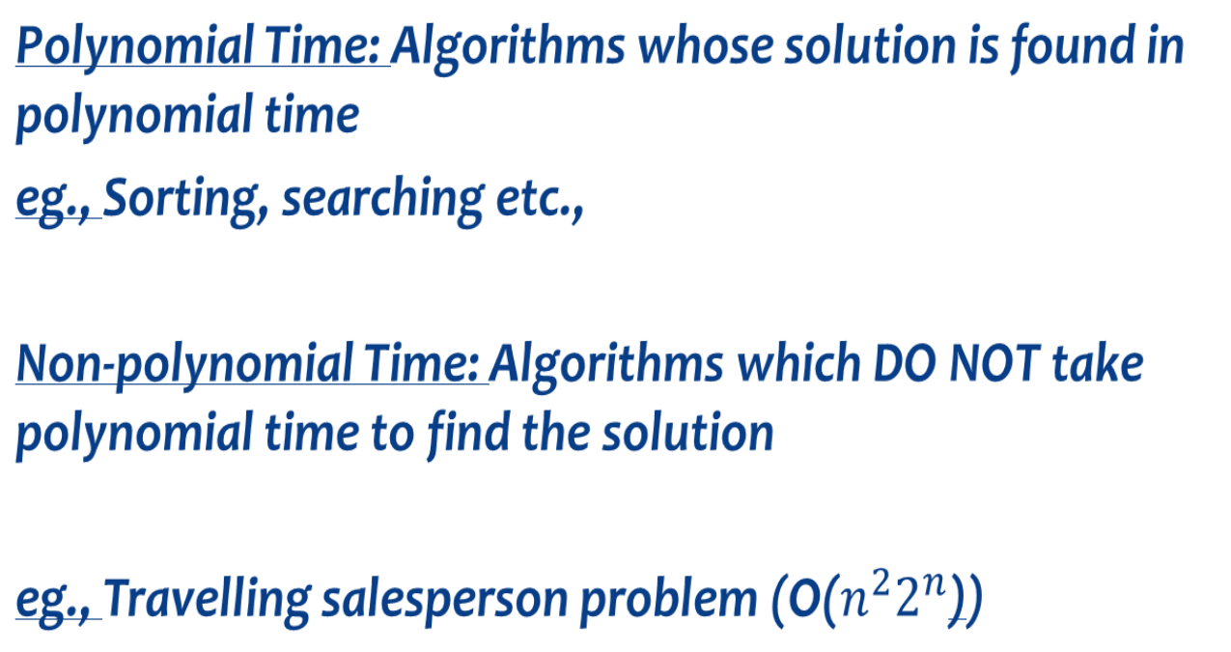
Time complexity

Slide 3
Introduction
Decision Problems
Optimisation Problems

Slide 4
Decision Problem
In computability theory, a decision problem is a problem that can be posed as a yes-no question of the input values.
Ex: “Given two numbers x and y, does x evenly divide y?".
The answer is either 'yes' or 'no' depending upon the values of x and y.

Slide 5
Optimisation Problems
An optimization problem is the problem of finding the best solution from all feasible solutions.
find a solution in the feasible region which has the minimum (or maximum) value of the objective function.

Slide 6
P and NP Problems
P is set of decision problems that can be solved in polynomial time by a deterministic computer: which means that at any time during the computation, the next computation step is uniquely determined.
These problems can be solved in time O(n^{k}) in worst-case, where k is constant.
These problems are called tractable, while others are called intractable or superpolynomial.

Slide 7
Intractable Problems
As the Problem size grow large, we are unable to solve them in reasonable time
What constitutes reasonable time?
Standard working definition: polynomial time
On an input of size n the worst-case running time is O(n^{k}) for some constant k
Polynomial time: O(n²), O(n³), O(1), O(n lg n)
Not in polynomial time: O(2^{n}), O(n^{n}), O(n!)

Slide 8
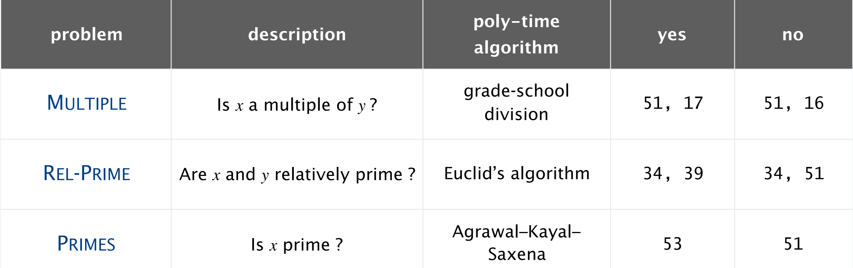
Examples: P Problems

Slide 9
NP Problems
NP (nondeterministic polynomial time) is the set of problems that can be solved in polynomial time by a nondeterministic computer.
Non-deterministic machine basically tries all alternatives in parallel, with the time complexity being equal to the longest path (always polynomial length) in the potentially exponentially wide search tree.
Thus, the class NP are those problems that can be tested/verified in polynomial time.
Deterministic implementations of non-deterministic machines require checking all possible solutions leading to exponential time complexity

Slide 10
Nondeterminism
In a non-deterministic algorithm, there are one or more possibilities for being the next computation step, and the algorithm chooses one of them.
Think of a non-deterministic computer as a computer that magically “guesses” a solution, then has to verify that it is correct
If a solution exists, computer always guesses it.
One way to imagine it: a parallel computer that can freely spawn an infinite number of processes
Have one processor work on each possible solution
All processors attempt to verify that their solution works
If a processor finds it has a working solution
So: NP = problems verifiable in polynomial time

Slide 11
Example: NP
HAMILTON-PATH:
Given an undirected graph G = (V, E), does there exist a simple path P that visits every node?
Even though we don’t have a fast polynomial time algorithm to determine whether a graph contains a HAMPATH or not.
If such a path is discovered somehow (maybe with exponential time brute force searching) we could easily-work it out whether the path is HAMPATH or not, in polynomial time.
Here the certificate will be a Hamiltonian path from s to t itself in G if exists. So HAMPATH is in NP.

Slide 12
Example 2: NP
TSP is NP-Complete, first we have to prove that TSP belongs to NP.
In TSP, we find a tour and check that the tour contains each vertex once.
Then the total cost of the edges of the tour is calculated.
Finally, we check if the cost is minimum. This can be completed in polynomial time.
Thus TSP belongs to NP.

Slide 13
A Glimpse
So far:
P = problems that can be solved in polynomial time
NP = problems for which a solution can be verified in polynomial time
Unknown whether P = NP (most suspect not)

Slide 14
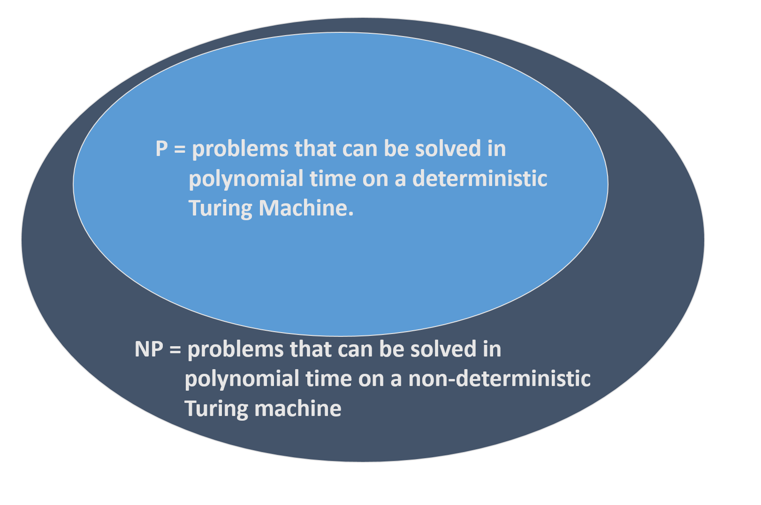
P ⊆ NP, because every problem in P has a solution in NP

Slide 15
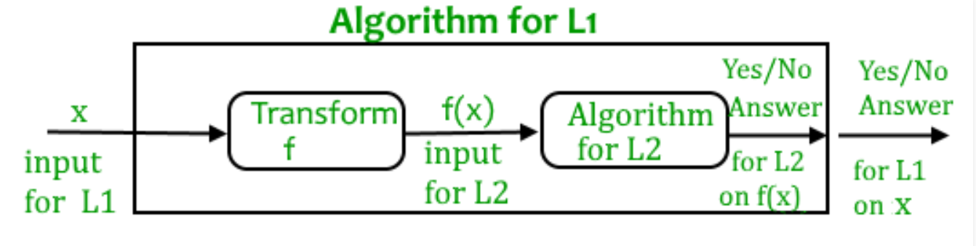
Reduction
Let L₁ and L₂ be two decision problems.
Suppose algorithm A₂ solves L₂. That is, if y is an input for L₂ then algorithm A₂ will answer Yes or No depending upon whether y belongs to L₂ or not.
The idea is to find a transformation from L₁ to L₂ so that the algorithm A₂ can be part of an algorithm A₁ to solve L₁.

Slide 16
NP Hard and NP Completeness
Problems for which there is no polynomial time complexity, are computationally related.
There are two classes of such problems:
NP HARD
NP COMPLETE

Slide 17
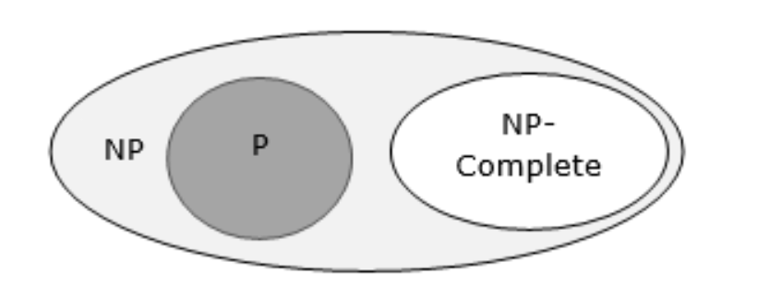
NP Complete
These are the hardest problems in NP. Such a problem is NP-hard and in NP.
A problem is in the class NPC if it is in NP and is as hard as any problem in NP.
If a polynomial time algorithm exists for any of these problems, all problems in NP would be polynomial time solvable. These problems are called NP-complete.

Slide 18
NP Completeness
The problem that is NP complete has the property that it can be solved in polynomial time if and only if all the other NP complete problems can be solved in polynomial time.

Slide 19
Examples: NPC
Satisfiability Problem
Clique Problem
Graph Coloring

Slide 20
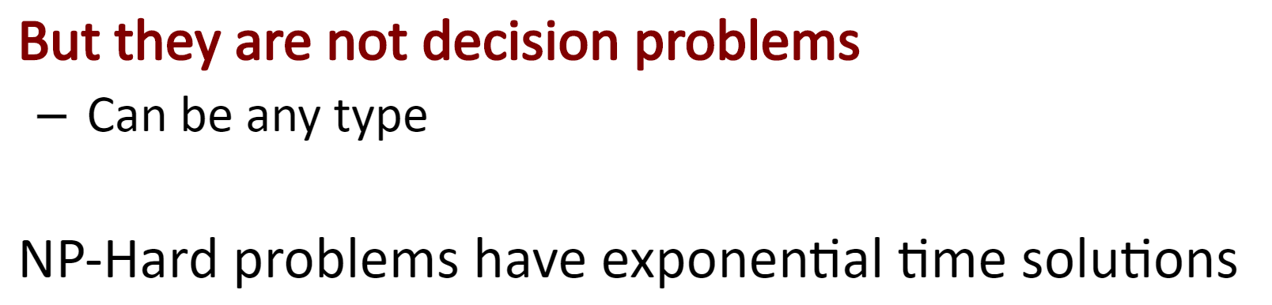
NP Hard Problems
At least as hard as the hardest problems in NP. Such problems need not be in NP; indeed, they may not even be decision problems.
The following problems are NP-Hard
The circuit-satisfiability problem
Set Cover
Vertex Cover
Travelling Salesman Problem

Slide 21
NP Hard and NP Complete
NP-hard-- Now suppose we found that A is reducible to B, then it means that B is at least as hard as A.
NP-Complete -- The group of problems which are both in NP and NP-hard are known as NP-Complete problem.

Slide 22
